Slide 1


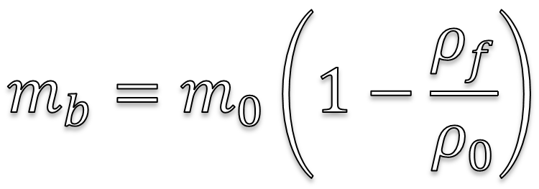
$$F_{s}= μ_{s}N$$
$$m_{b}=m_{0}\left(1−\frac{ρ_{f}}{ρ_{0}}\right)$$

